Slide 1
MODELLING FACTORS ASSOCIATED WITH HIV-FREE SURVIVAL AMONG EXPOSED INFANTS IN HOMA BAY COUNTY
AUGUSTINE GATIMU NJUGUNA
TM 406-3105/2015
Doctor of Philosophy in Epidemiology
20/02/2024
Seminar 1
Professor Simon Karanja
Jomo Kenyatta University of Agriculture & Technology
Late Dr. Peter Wanzala
Institute of Tropical Medicine and Infectious Diseases (ITROMID)

Slide 2
Background
Human immunodeficiency virus (HIV) is an infection with a global prevalence and currently no cure or vaccine.
Women living with HIV who become pregnant or who acquire the virus during pregnancy are at risk of both maternal and perinatal morbidity and mortality mainly if the virus is poorly controlled.
Furthermore, there is a risk of vertical transmission to the fetus during pregnancy labour and postpartum through breastfeeding.
Globally, the prevention of vertical HIV transmission programmes have made tremendous progress in reducing pediatric HIV infection.
Despite the progress made, achieving the elimination of vertical HIV transmission target has been challenging for most Sub-Saharan African countries due to the high burden of HIV among reproductive-age women in these countries

Slide 3
Problem Statement
Despite strategies to prevent mother-to-child transmission of the human immunodeficiency virus (HIV), infected children continue to be born.
Vertical transmission of HIV can be effectively controlled through antenatal screening, antiretroviral treatment and the services provided during and after childbirth for mother and newborn.
World-wide rate of MTCT of HIV is still far from reaching the zero transmission target, even in countries with consolidated screening programmes and standardized protocols of HIV management during pregnancy.
In 2022 Homa Bay County had 4510 mother baby pair Receiving PMTCT services with 8.7 percent of infants getting infected with HIV which implies that more efforts are needed in order to reduce mother to child transmission of HIV.

Slide 4
Justification
Despite progress in reducing infant mortality due to HIV/AIDS, the disease continues to have a devastating impact on infants worldwide.
Factors causing diseases are dispersed unevenly across communities and regions, and the processes that bring people and disease-causing agents into contact vary geographically.
The environment, including physical, social, and economic factors, significantly influences people's health. Geography, particularly the use of geographic information systems, has been instrumental in understanding health-related issues.
Advances in data collection methods, geographic visualization techniques, and modeling have helped identify spatial patterns and disease spread probability.
This study aims to provide insight into the determinants of vertical HIV transmission, filling a critical knowledge gap in the field of epidemiology.

Slide 5
Specific Objectives
Determine survival rate of HIV exposed infants in Homa Bay County.
Determine the maternal factors associated with HIV antigen positivity among exposed infants in Homa Bay County.
To determine infant factors associated with HIV antigen positivity among exposed infants in Homa Bay County.
To develop a model on HIV-free survival among infants born to HIV-positive mothers in Homa Bay County.

Slide 6
Conclusion
HIV-free survival among infants born to HIV-positive mothers in Homa Bay County.
Maternal factors associated with HIV antigen positivity
Infant factors associated with HIV antigen positivity
Geographical factors associated with HIV antigen positivity
Demographic and Social-economic factors associated with HIV antigen positivity

Slide 7
Methodology
The research employed a longitudinal cohort design.
The study was conducted among infants born of HIV positive mothers.
Study Area
The study was carried out in Homa Bay County.
The county covers an area of 3,183.3 sq km with a projected in 2023 of about 1,231,659 people.
Homa-Bay sub county, 40 (12%) were from Kabondo Kasipul sub county, 63 (19%) were from Karachuonyo sub county, 46 (14%) were from Kasipul sub county, 30 (9%) were from Mbita sub county, 23 (7%) were from Ndiwa sub county, 57 (17%) were from Rangwe sub county, and 43 (13%) were from Suba sub county.

Slide 8
Sample size determination
The general formula for the required number of subjects in a survival study may be expressed as
Stpower command
stpower cox, power(0.95) hratio(0.37) failprob(0.17) wdprob(0.05)
Estimated number of events and sample size:
E (expected number of events) = 53
N (sample size required) = 326

Slide 9
Data Analysis
Results presented as percentages and frequencies for categorical variables, mean ± SD for discrete/continuous variables
Chi-square test used for comparisons
Kaplan Meier and log rank methods used to analyze impact of factors on HIV antigen positivity
Bivariate and multivariate logistic regression analysis used to define risk associated with HIV antigen positivity
Bivariate and multivariate Cox proportional hazards regression analysis used to determine hazard ratios associated with HIV antigen positivity

Slide 10
Data Analysis Cont’d
Variables with p < 0.05 in bivariate analysis included in multivariate analysis using addition method
Multivariate analysis adjusted to identify best model
Spatial analysis conducted using conditional autoregressive method with Moran I and Geary Indices, as well as Bayesian modeling
Spatial scan method used to identify clustering of HIV antigen positivity, spatial autocorrelation method used to establish randomness
Bayesian modeling employed to evaluate spatial factors associated with HIV antigen positivity in Homa-Bay County
R program and STATA used for all analyses.

Slide 11
Results
Total baby mother pair recruited | 337
Lost to follow up | 12 | 3.6 %
Number of respondents per sub county
Homa Bay Town | 35 | 10 %
Kabondo Kasipul | 40 | 12 %
Karachuonyo | 63 | 19 %
Kasipul | 46 | 14 %
Mbita | 30 | 9 %
Ndhiwa | 23 | 7 %
Rangwe | 57 | 17 %
Suba | 43 | 13 %
Gender
Male | 156 | 46 %
Female | 181 | 54 %

Slide 12
HIV status at 18 months | Frequency | Percentage
Positive | 34 | 10.42 %
Negative | 292 | 89.58 %
HIV positive at 18 months
Male | 18 | 54.54 %
Female | 15 | 45.46 %
HIV negative at 18 months
Male | 131 | 44.86 %
Female | 161 | 55.14 %

Slide 13
Birth PCR | Frequency | Percentage
Positive | 6 | 2 %
Negative | 331 | 98 %
Second PCR at 6 weeks
Positive | 8 | 2.4 %
Negative | 329 | 97.6%
Third PCR at 6 months
Positive | 16 | 4.8 %
Negative | 318 | 95.2 %
Fourth PCR at 1 year
Positive | 33 | 10.1
Negative | 295 | 89.9 %
Antibody test at 18 months
Positive | 34 | 10.42 %
Negative | 292 | 89.58 %

Slide 14
Time of diagnosis of mother with HIV | Frequency |  | Percent (%)
Before pregnancy | 324 |  | 4 %
During antenatal care | 13 |  | 96%
HIV Antigen Positivity Prevalence By the Time of Mothers Diagnosis
During antenatal care
Positive |  | 13 | 50%
Negative |  | 13 | 50%
Before pregnancy
Positive |  | 20 | 6.64 %
Negative |  | 281 | 93.36 %

Slide 15
 | Frequency | Percentage
Stage I
Positive | 7 | 2.15 %
Negative | 147 | 45.09 %
Stage II
Positive | 6 | 1.84 %
Negative | 134 | 41.1%
Stage III
Positive | 4 | 1.84%
Negative |  | 2.45 %
Stage IV
Positive | 12 | 3.68
Negative | 6 | 1.84

Slide 16
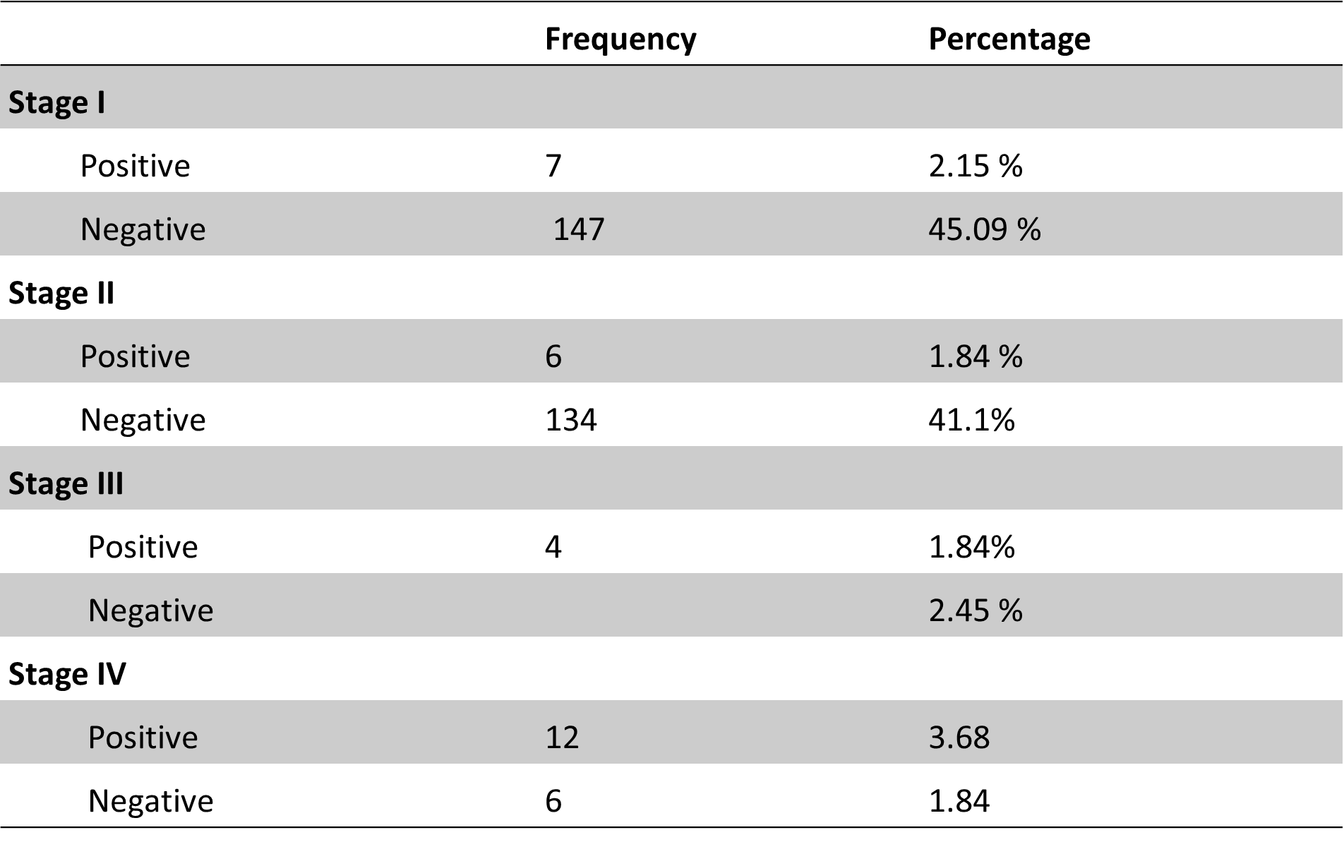

Slide 17
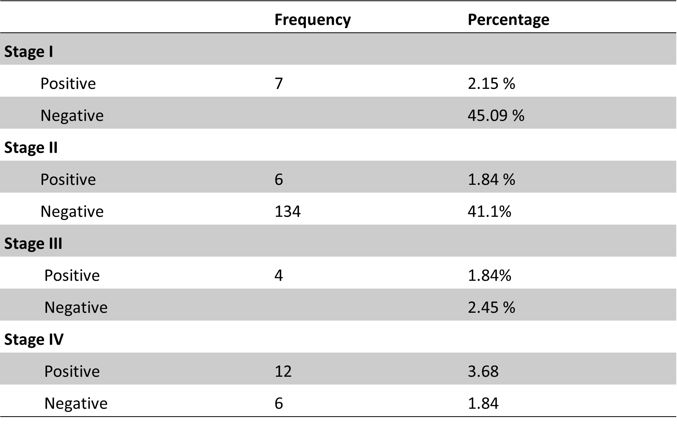

Slide 18
Results cont’d
Total number of baby-mother pairs recruited: 337
Lost to follow-up: 12 (3.6%)
Babies tested positive for HIV at the end of the study: 34 (10.43%)
Babies tested negative for HIV at the end of the study: 292 (89.57%)
HIV-positive babies gender distribution: 18 males (54.54%), 15 females (45.46%)
HIV-negative babies gender distribution: 131 males (44.86%), 161 females (55.14%)
PCR results at birth: 6 (2%) babies tested positive, 331 (98%) tested negative
PCR results at 6 weeks: 8 (2.45%) babies tested positive, 329 (97.6%) tested negative
PCR results at 6 months: 16 (4.8%) babies tested positive, 318 (95.2%) tested negative

Slide 19
Results cont’d
PCR results at 1 year: 33 (10.1%) babies tested positive, 295 (89.9%) tested negative
Antibody test at 18 months: 34 (10.42%) babies tested positive, 292 (89.58%) tested negative
Mothers diagnosed with HIV before pregnancy: 324 (96%)
Mothers diagnosed with HIV during antenatal care: 13 (4%)
Higher prevalence of HIV antigen positivity in babies born to mothers diagnosed with HIV very late during antenatal care: 13 (50%)
Prevalence of HIV antigen positivity based on WHO staging: WHO stage I - 7 (2.14%), stage II - 6 (1.84%), stage III - 4 (1.84%), stage IV - 12 (3.68%)

Slide 20
Discussion
The study aimed to identify factors responsible for HIV antigen positivity in babies born to HIV positive mothers
Gender distribution: 54.54% HIV-positive males, 45.46% HIV-positive females; 44.86% HIV-negative males, 55.14% HIV-negative females
PCR results showed increasing rate of HIV antigen positivity from 2% at birth to 10.1% at 1 year
Higher prevalence of HIV antigen positivity in babies born to mothers diagnosed with HIV late during antenatal care.
Findings supported by previous studies on prevalence and transmission of HIV among mother-infant pairs in Rwanda(Remera, E, et al 2021)

Slide 21
Conclusion
Understanding factors associated with HIV antigen positivity important for improving prevention and management strategies, as recommended by WHO and UNAIDS.
Findings from this study indicate a strong need to identify and treat reproductive age women with HIV as soon as possible and enroll them even before conception into antenatal care programs to ensure retention in care and administer prompt postpartum ART prophylaxis to children.

Slide 22
References
REFERENCES
AVERT. An international AIDS Charity. Avert.org Worldwide HIV/AIDS epidemic statistics, 2005, http://www.avert.org/worlstatinfo.htm.
Becquet, M. Marston, F. Dabis, L. H. Moulton, G. Gray, et al., “Children Who Acquire HIV Infection Perinatally Are at Higher Risk of Early Death than Those Acquiring HIV through Breastmilk: A Meta-Analysis,” PLoS One, Vol. 7, No. 2, 2012, p. e28510.
Becquet, R., Bequet, L., Ekouevi, D. K., Viho, I., Sakarovitch, C., Fassinou, P., ... & ANRS 1201/1202 Ditrame Plus Study Group. (2007). Two-year morbidity–mortality and alternatives to prolonged breast-feeding among children born to HIV-infected mothers in Côte d'Ivoire. PLoS medicine, 4(1), e17.
Bhutta ZA, Ahmed T, Black RE, et al. What works? Interventions for maternal and child under nutrition and survival. Lancet. Feb 2 2008; 371(9610):417-440.
Bomsel M, Alfsen A. Entry of viruses through the epithelial barrier: Pathogenic trickery. Nat Rev Mol Cell Biol. 2003; 4(1):57–68. doi: 10.1038/Nrm1005 PMID: ISI:000180170900016.
Bomsel M, Heyman M, Hocini H, Lagaye S, Belec L, Dupont C, et al. Intracellular neutralization of HIV transcytosis across tight epithelial barriers by anti-HIV envelope protein dIgA or IgM. Immunity. (2008); 9 (2):277–87. Epub 1998/09/05. PMID: 9729048.
Becquet, R., Marston, M., Dabis, F., Moulton, L. H., Gray, G., Coovadia, H. M., ... & Kilewo, C. (2012). Children who acquire HIV infection perinatally are at higher risk of early death than those acquiring infection through breastmilk: a meta-analysis. PloS one, 7(2), e28510.
Berhan, Z., Abebe, F., Gedefaw, M., Tesfa, M., Assefa, M., & Tafere, Y. (2014). Risk of HIV and associated factors among infants born to HIV positive women in Amhara region, Ethiopia: a facility based retrospective study. BMC research notes, 7(1), 876.
Coutsoudis A, Pillay A, Kuhn L , Spooner E, Tsai EW, Coovadia H. Methods of feeding and transmission of HIV-1 from mothers to children by 15 months of age: prospective cohort study from Durban, South Africa. AIDS. 2001;115:379- 387.
Coutsoudis A, Pillay A, Kuhn L , Spooner E, Tsai EW, Coovadia H. Methods of feeding and transmission of HIV-1 from mothers to children by 15 months of age: prospective cohort study from Durban, South Africa. AIDS. 2009;115:379- 387.
Cournil A, De Vincenzi I, Gaillard P, et al.; Kesho Bora Study Group. Relationship between mortality and feeding modality among children born to HIV-infected mothers in a research setting: the Kesho Bora study. AIDS. 2013;27:1621–1630.
C King, C., R Ellington, S., & P Kourtis, A. (2013). The role of co-infections in mother-to-child transmission of HIV. Current HIV research, 11(1), 10-23.
CSA, ICF International: Ethiopia Demographic and Health Survey (2011), Addis Ababa, Ethiopia and Calverton, Maryland, USA: Central Statistical Agency and ICF International.
Coovadia HM, Rollins NC, Bland RM, Little K, Coutsoudis A, Bennish ML. Mother-to-child transmission of HIV-1 infection during exclusive breastfeeding in the first 6 months of life: an intervention cohort study. Lancet. 2009;369(9567):1107-16. Epub 2010/04/03.
Creek TL, Sherman GG, Nkengasong J, Lu L, Finkbeiner T, Fowler MG, et al.
Infant human immunodeficiency virus diagnosis in resource-limited settings:
issues, technologies, and country experiences. Am J Obstet Gynecol. 2007;
197(3 Suppl):S64–71.
Cournil A, De Vincenzi I, Gaillard P, et al.; Kesho Bora Study Group. Relationship between mortality and feeding modality among children born to HIV-infected mothers in a research setting: the Kesho Bora study. AIDS. (2013); 27:1621–1630.
Coovadia HM, Rollins NC, Bland RM, et al. Mother-to-child transmission of HIV-1 infection during exclusive breastfeeding in the first 6 months of life: an intervention cohort study. Lancet. 2007;369:1107–1116.
C. Diaz, C. Hanson, E. R. Cooper, J. S. Read, J. Watson,H. A. Mendez, J. Pitt, K. Rich, V. Smeriglio and J. F. Lew, “Disease Progression in a Cohort of Infants with Vertically Acquired HIV Infection Observed from Birth: The Women and Infants Transmission Study (WITS),” Journal of Acquired Immune Deficiency Syndromes and Human Retrovirology, Vol. 18, No. 3, 1998, pp. 221-228. doi:10.1097/00042560-199807010-00004
Creek TL, Sherman GG, Nkengasong J, Lu L, Finkbeiner T, Fowler MG, et al.Infant human immunodeficiency virus diagnosis in resource-limited settings: issues, technologies, and country experiences. Am J Obstet Gynecol. 2007; 197(3 Suppl):S64–71.

Slide 23
Acknowledgements
I would like to express my sincere gratitude to the following individuals and organizations for their invaluable contribution and support throughout the completion of this study.
1. Professor Simon Karanja
Jomo Kenyatta University of Agriculture & Technology
2. Late Dr. Peter Wanzala
Institute of Tropical Medicine and Infectious Diseases (ITROMID)
3.Kemri Graduate School

